Slide 1
Simple IoT Application
Youmna Sabik
900160339
GitHub: https://github.com/youmnasabik/Project

Slide 2
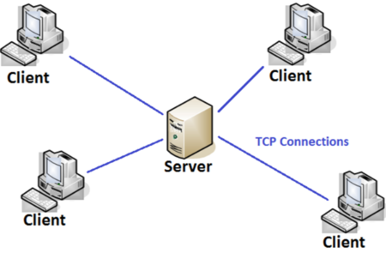
Project Description
-The project aims to control the I/O operations on the STM32 module using the RTC module to retrieve the Date and time through a web page interface.
-It is a client server architecture where the ESP8266 module acts as a WiFi access point that connects the Server, STM32 module, to display the Time and date to the client, web page,based on his request, where the Time and date are retrieved from the STM32 module.
-It also controls the LEDs of STM32 module

Slide 3
Demo Deliverables
STM32 module is connected to RTC module
ES8266 connects STM32 module to display data to user based on his request through webpage
STM32 receives special characters and act accordingly
Returns current date and time
Turn led on
Turn led off

Slide 4
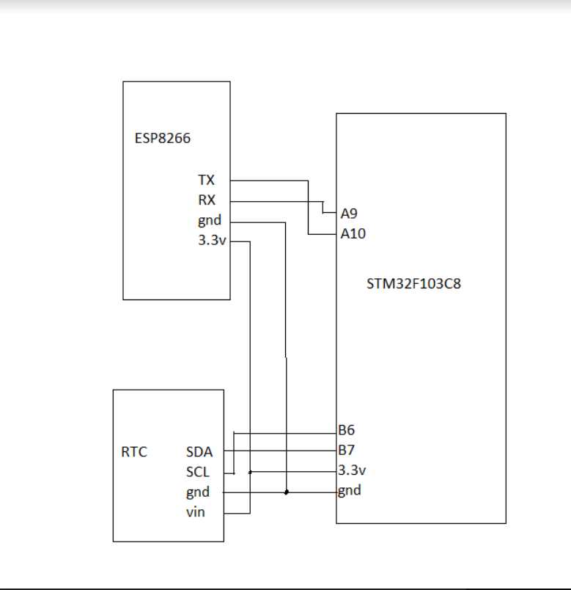
Connection (Block Diagram)

Slide 5
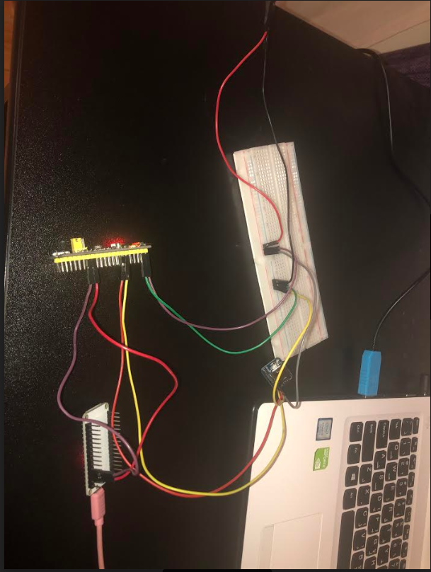
Connection (circuit)

Slide 6
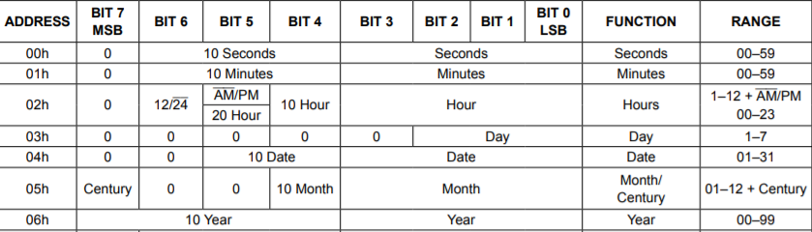
RTC Module
I made the value of the registers hardcoded on Tuesday 26-5-2020 at 9 Am and filled the registers accordingly
-Seconds: is all set to zeros as set to 9AM sharp -Minutes: is all set to zeros as set to 9AM sharp -Hours: 9Am = 9, so will be using the 24 hour therefore set bit 6 to 0, bit 5 to 0 because 9 hours less than 20. Also set bit 4 to zero because less than 10 hours. Then filling bit 0 to bit 3 by “9” --->00001001 -DAY: Based on my assumption, Tuesdayis set to be 3 so will fill register with value 0x03 -DATE: since its day 26, therefore bit 5 and 4 set to 10 corresponding to 20 days, and from bit0 to bit 3 filled with remaing 6 days 00(10)0110 -Month: since its May so its value will be set to 0x05 -Year: since it is 2020, so its value is set to 0x20

Slide 7

Code
*secbuffer[0] = 0x00; secbuffer[1] = 0x00; //data to put in register 0 SEC
*minbuffer[0] = 0x01; minbuffer[1] = 0x00; //data to put in register O MIN
*hourbuffer[0] = 0x02; hourbuffer[1] = 0x23; //data to put in register 00001001 =9Am
*DAY[0] = 0x03; DAY[1] = 0x02; //data to put in register Tuesday=3
*DATE[0] = 0x04; DATE[1] = 0x26; //data to put in register date=26
*MONTH_CENTURY[0] = 0x05; MONTH_CENTURY[1] = 0x05; //data to put in register MAY= 5
* YEAR[0] = 0x06; YEAR[1] = 0x20; //data to put in register 20
Ex:

Slide 8
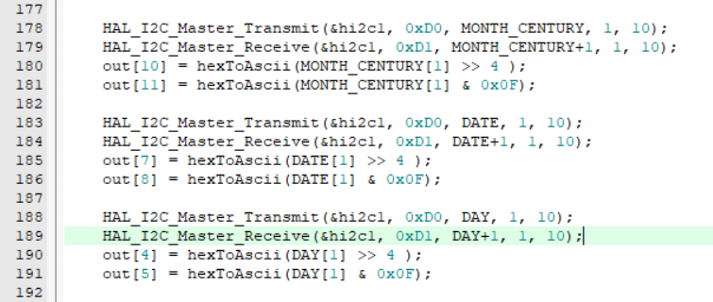
Code#2
uint8_t out[] = {'D','A','Y','=',0,0,',',0,0,'-',0,0,'-',0,0,'\r','\n','T','I','M','E','=',0,0,':',0,0,':',0,0,'\r','\n'};

Slide 9
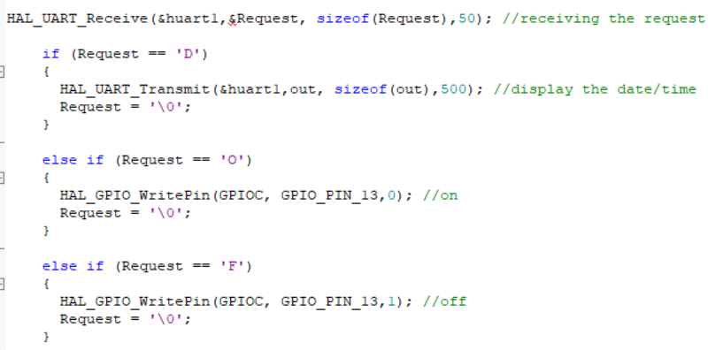
Assumptions
1 | 2 | 3 | 4 | 5 | 6 | 7
Sunday | Monday | Tuesday | Wednesday | Thursday | Friday | Saturday
Assuming That in STM32F103C8 I received from the user
D-> Means user requested date and time
O->turning on the led
F-> turning off the led

Slide 10
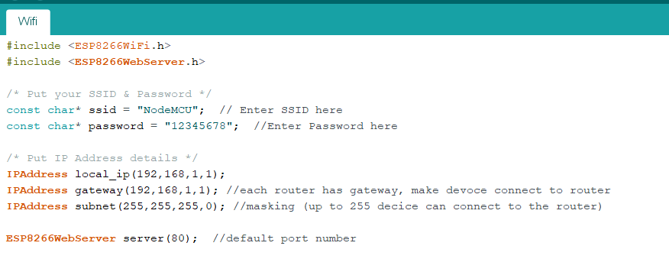
ESP8266
Initially, setting SSID name and password. In addition, setting local_IP, gateway so that each router has a gateway to make the devices connect to router and subnet which is used to define how many devices can be connected to the router and here they are 255 devices

Slide 11
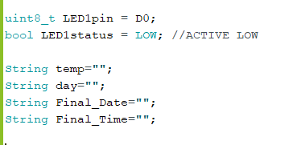
Declarations
String temp is used to store all the output(date and time) received from STM32 module. While string day is used to store only one bit of temp which identifies the day based on the assumption i made. Finally, I display the output on website on two lines, one representing date and other representing time.

Slide 12
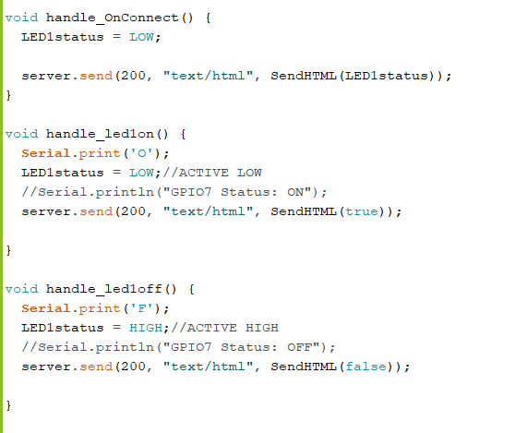
Functions
For turning led on, ‘O’ is transmitted to the STM32 module and this turns the led on.
For turning led off, ‘F’ is transmitted to the STM32 module and this turns the led off.

Slide 13
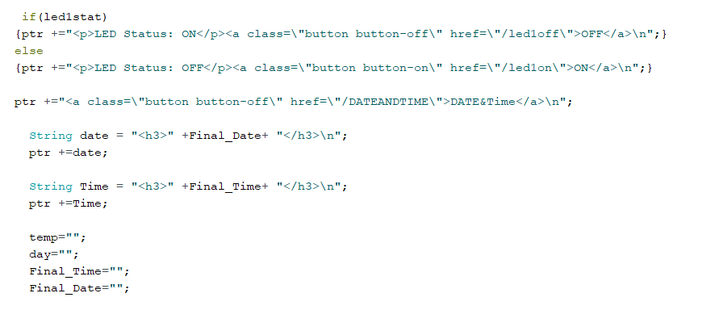
SendHTML Function
This shows how the date and time are outputted on the web page when user request them by clicking on button. And after they are displayed, I clear all the strings (temp,day,Final_Time,Final_Date)

Slide 14
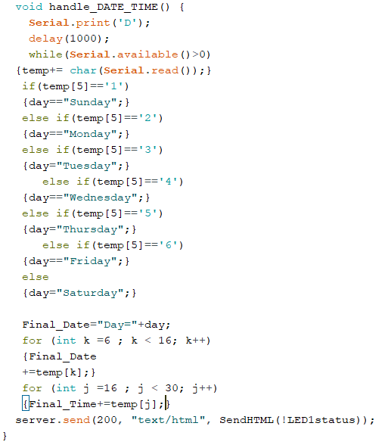
When the user clicks on the Date & Time button,the handle_DATE_TIME function is executed so that it transmits ‘D’ to STM32 module and based on this the STM32 transmits the current date and time to the user. The stm32 module transmits week days as numbers and based on the assumption as mentioned before. In this function, I make if conditions on 5th character of temp string as it is the character that identifies the week day based on the order of output of keil code.
It is already known from the keil code that output of date and time is 29 characters and that time part starts from character 16 to 29. While date part start from character 6 to character 15.
The Final_date= day(which is already known from if conditions based on 5th character) + characters from 6 to 15.

Slide 15
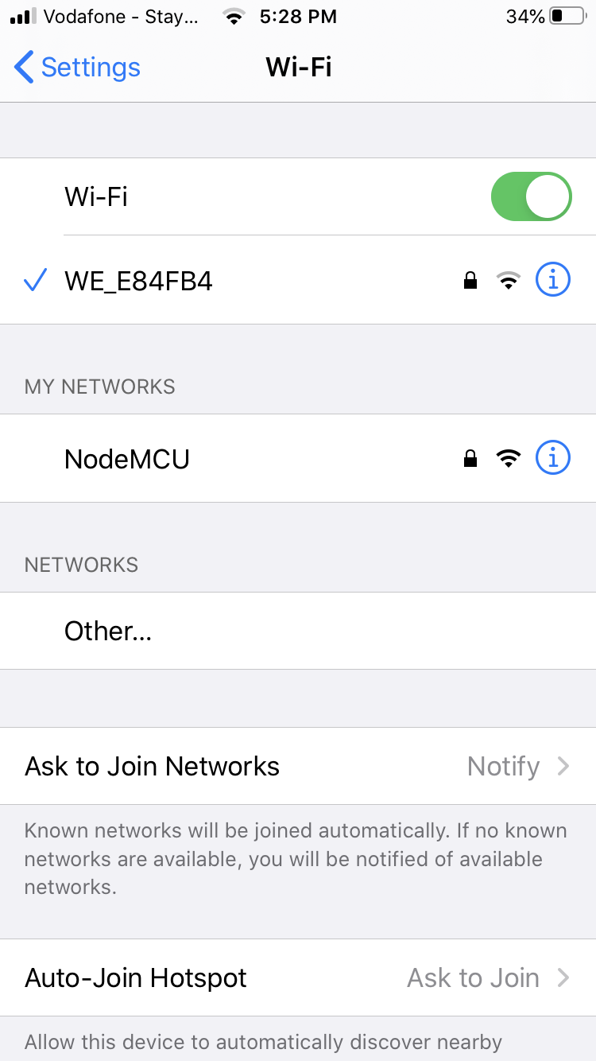
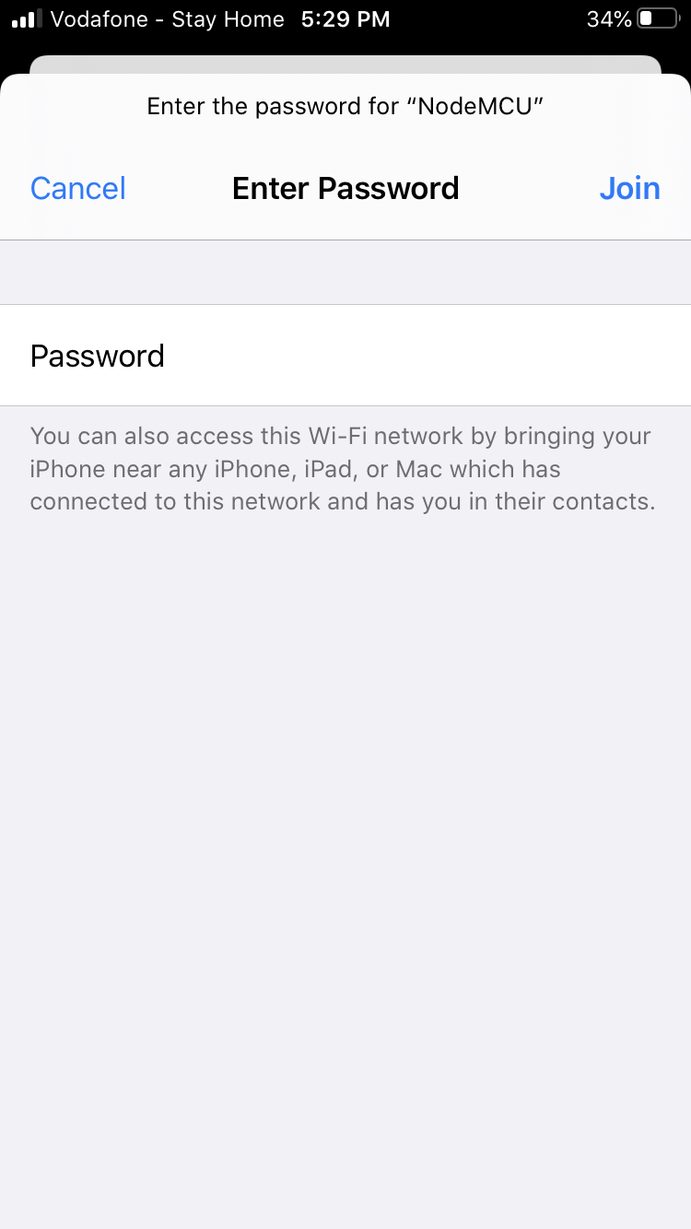
WiFi Connection

Slide 16
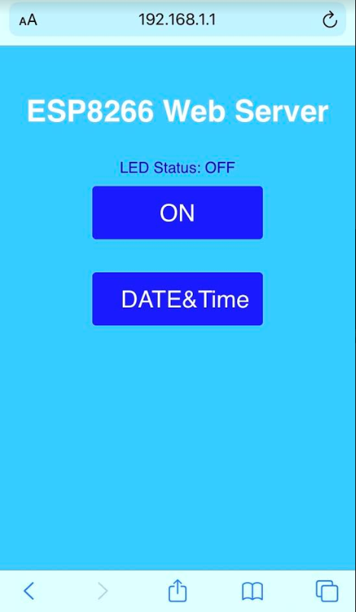
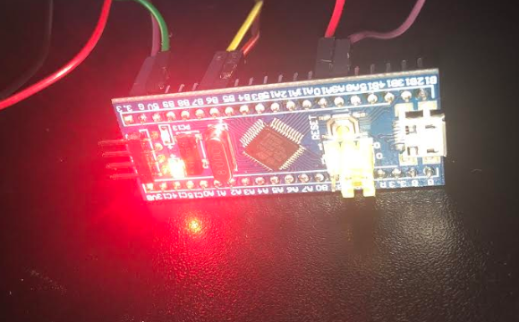
LED Status: OFF

Slide 17
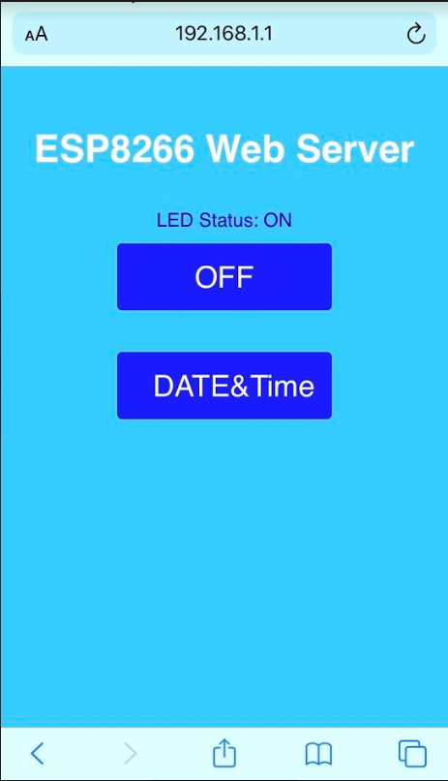
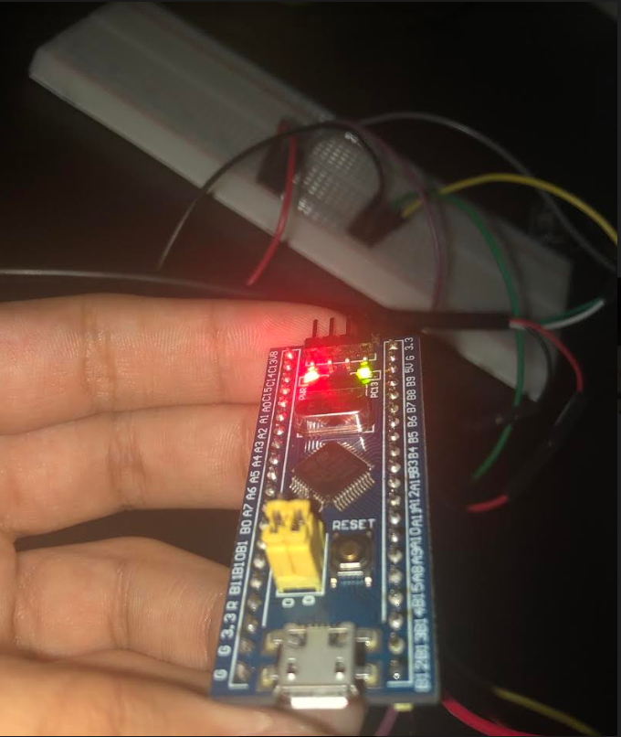
LED Status: ON

Slide 18
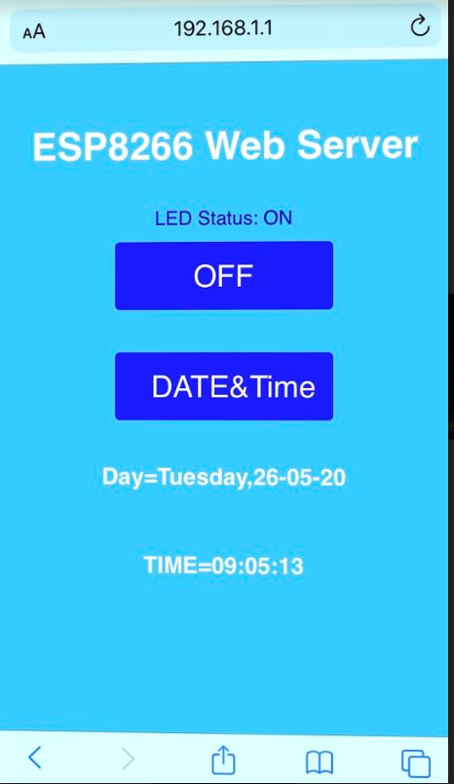
DATE&Time

Slide 19
Output
https://drive.google.com/drive/folders/1-6FqKXK60jvp6SmCQqOgCML7yRkypbw0

Slide 20
References
https://lastminuteengineers.com/creating-esp8266-web-server-arduino-ide/
https://www.espressif.com/sites/default/files/documentation/0a-esp8266ex_datasheet_en.pdf
https://blackboard.aucegypt.edu/bbcswebdav/pid-1577852-dt-content-rid-11605851_1/courses/CSCE430204_2020Sp/DS3231%20datasheet.pdf
https://blackboard.aucegypt.edu/bbcswebdav/pid-1558189-dt-content-rid-11337585_1/courses/CSCE430204_2020Sp/Description%20of%20STM32F1%20HAL%20and%20low-layer%20drivers%20%28en.DM00154093%29.pdf

